Slide 1

Eniac Discounts???

Slide 2

93 % of the sold products are discounted
Source: unsplash.com

Slide 3

97% of the revenue from discounted products
Source: unsplash.com

Slide 4
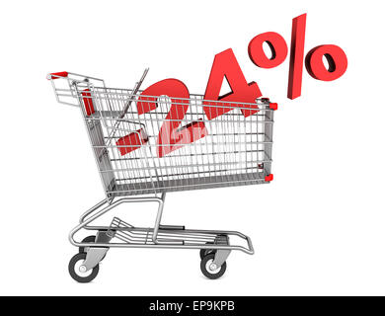
Discounts in average:
Source: unsplash.com

Slide 5
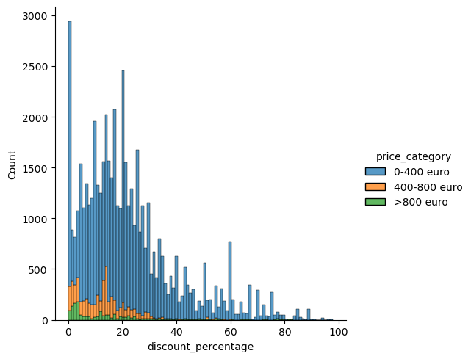
Discounts are larger by cheaper products (<400 €)
Number of orders
Discounts in%
Notes:
cheap products are discounted more

Slide 6

88% of the orders are with cheap products (<400 €)
Source: unsplash.com
Notes:
data distribution

Slide 7
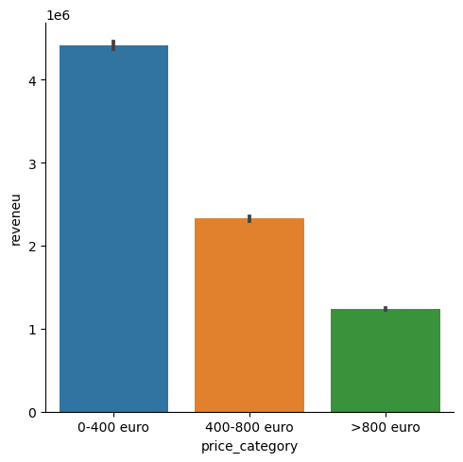
The most revenue comes from cheap products
Total paid price €
Price category
le6

Slide 8
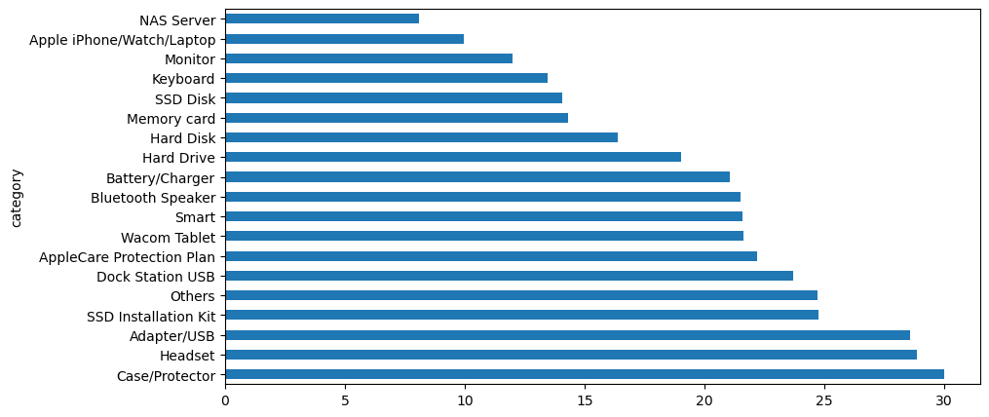
Higher discounts by cheap products
Discounts in%

Slide 9
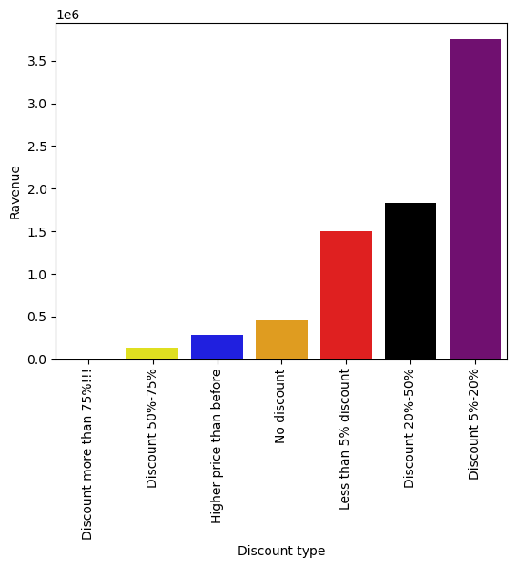
Discounts 5%-20% responsible for majority of Eniac revenue

Slide 10
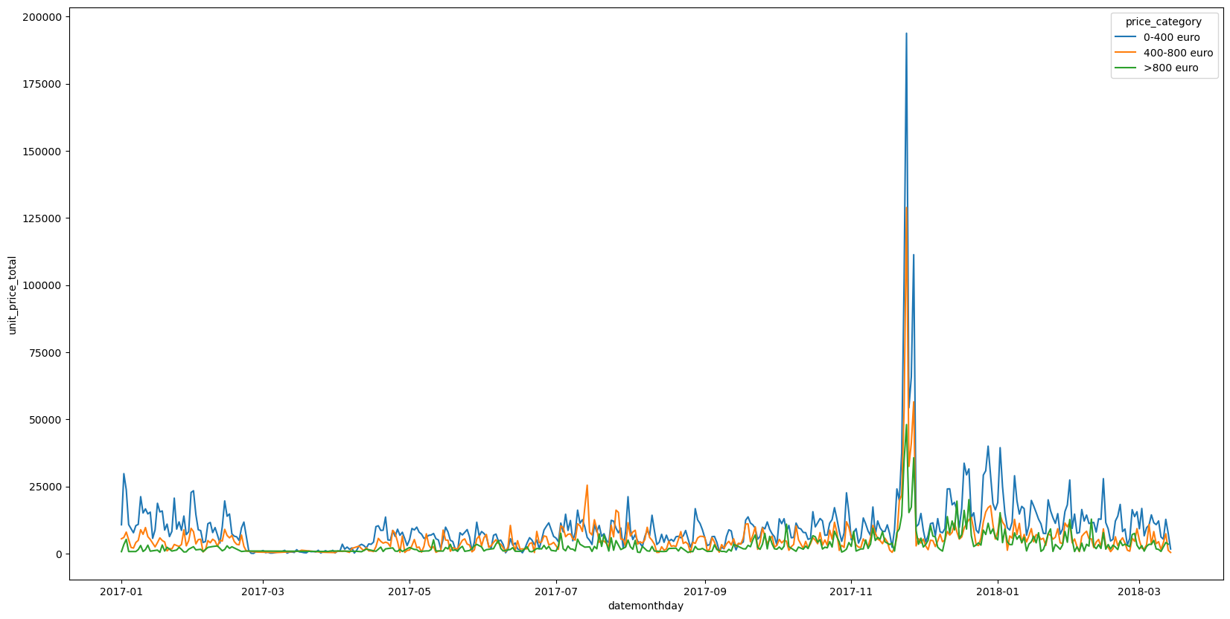
Very small revenue: mid February till mid April
Very high: Black Friday - Cyber Monday

Slide 11
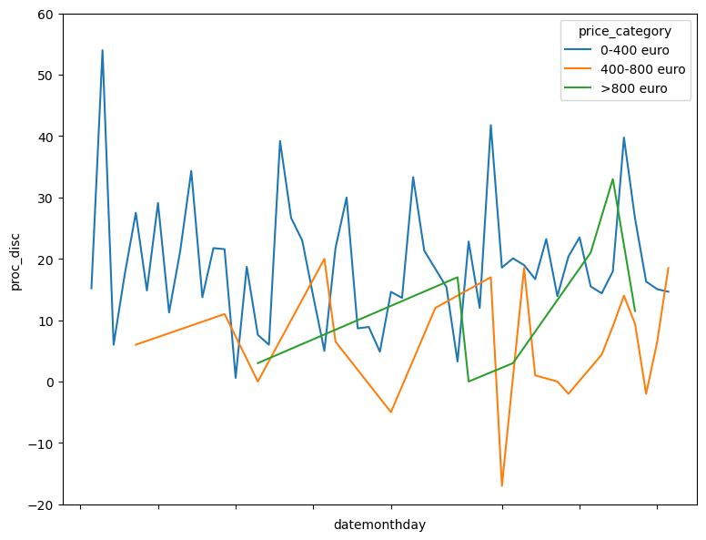
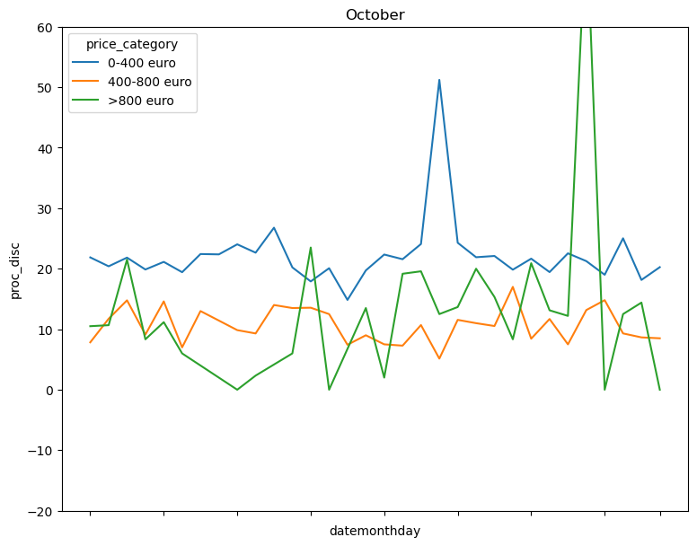
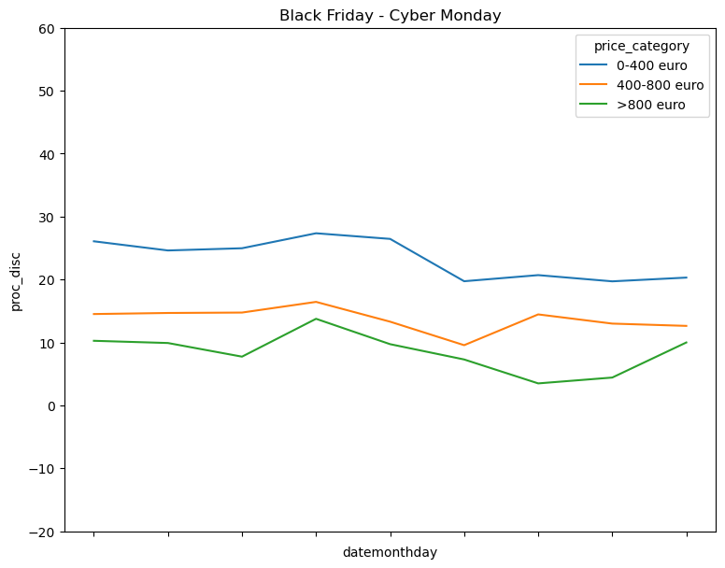
All products
Products 400€-800€ have higher discounts during Black Friday or October, than in March
23rd February - 16th April 2017
almost no sells
October - ‘normal’ month
Black Friday - Cyber Monday

Slide 12
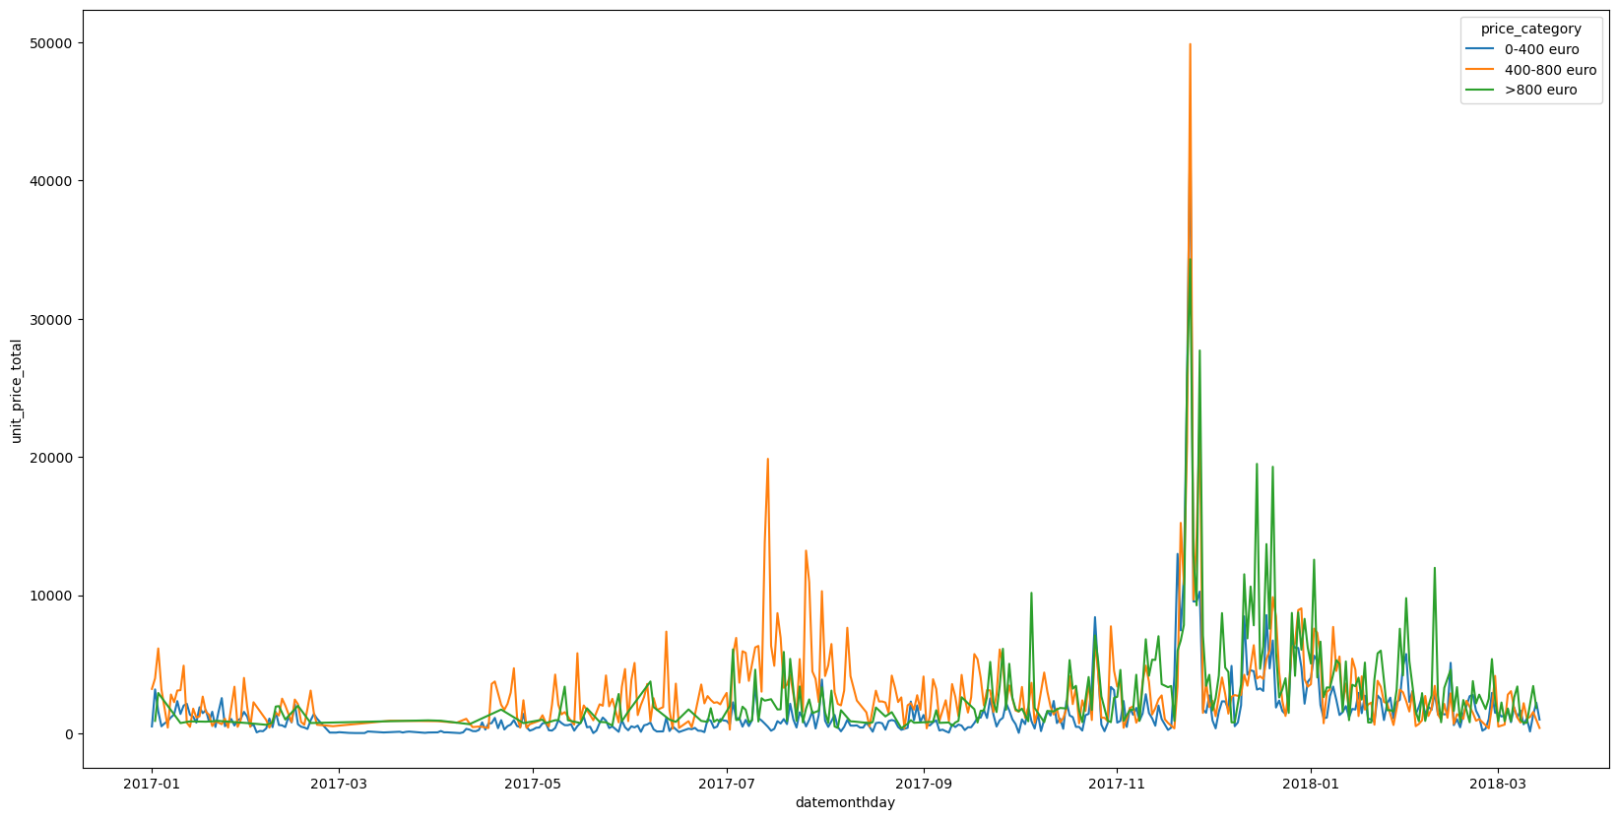
Apple products : almost no sells mid February till mid April

Slide 13
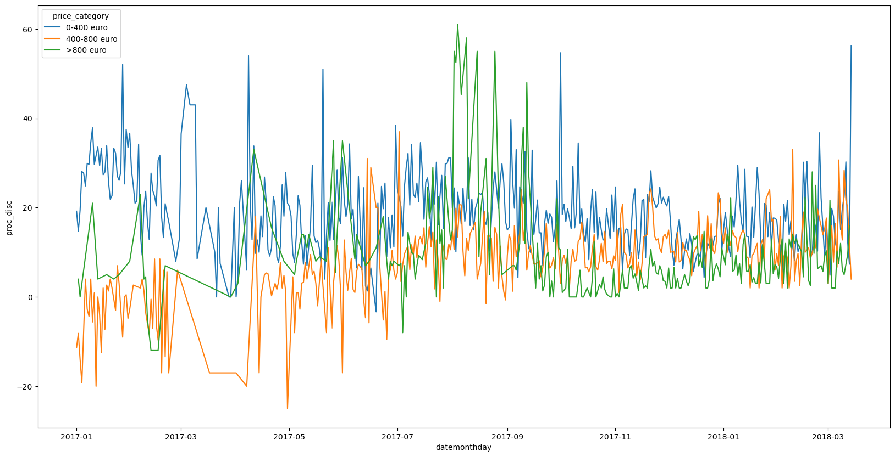
Apple products: % of discount

Slide 14
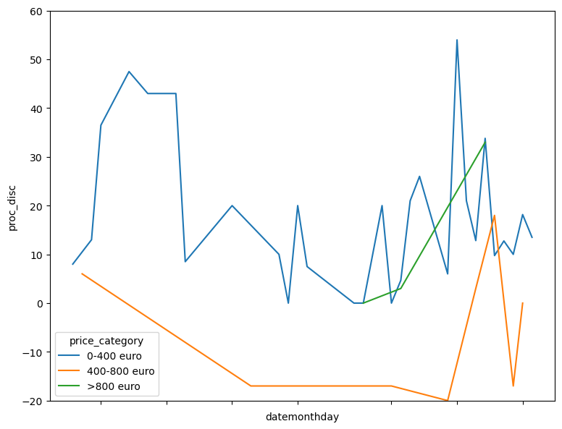
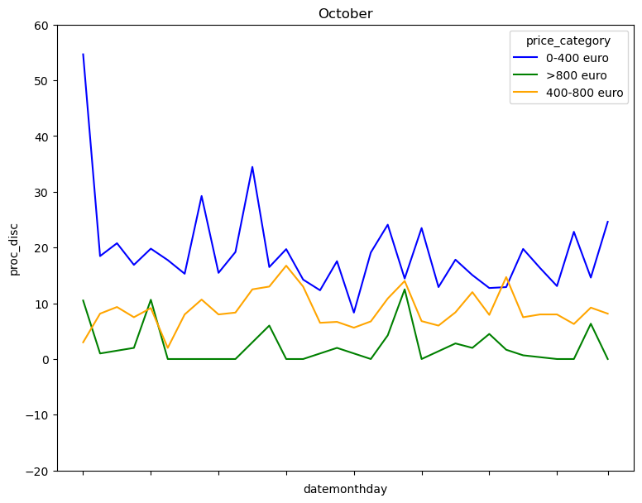
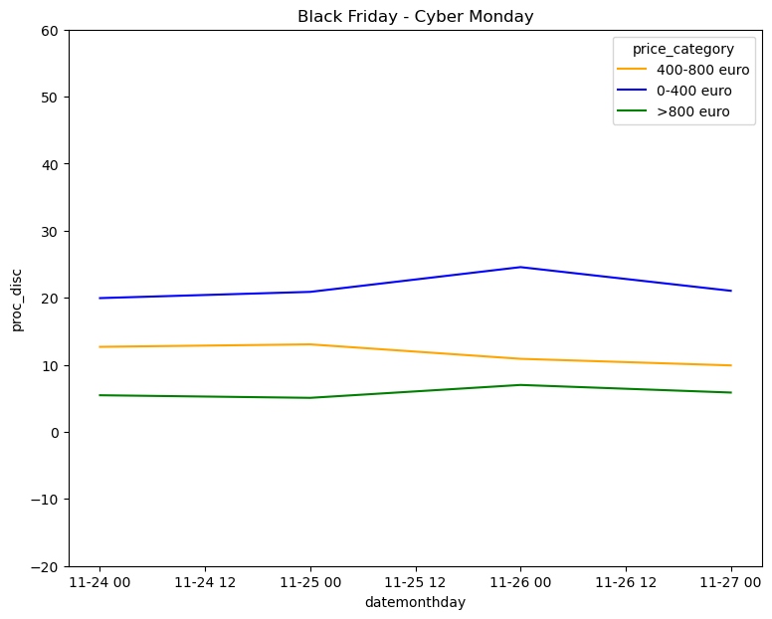
Apple products
Discounts are needed
23rd February - 16th April 2017
almost no sells
October - ‘normal’ month
Black Friday - Cyber Monday

Slide 15
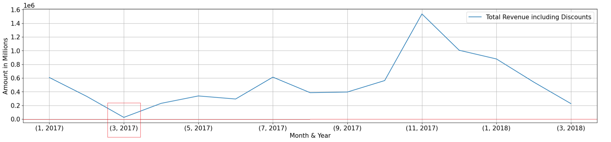
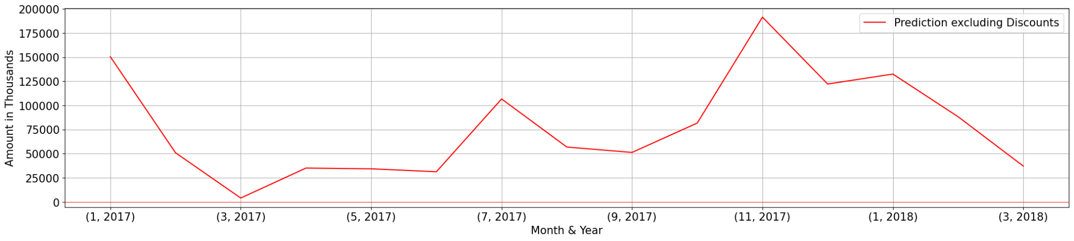
Revenue excluding Discounts

Slide 16

Discounts are recommended
The majority of Eniac's revenue comes from 5-20% discounted products.
Receiving high revenue during popular sales such as Black Friday, Cyber Mondays and the Festive seasons.
The lower price ranges have higher discounts.

Slide 17
Appendix

Slide 18
Conclusions
We recommend discounts.
Higher discounts are from the cheaper price ranges
receiving high revenue during popular sales such as Black Friday, Cyber Mondays and the Festive season.
Higher discounts are recommended for cheap products and lower discounts are recommended for higher priced products.
Most of the Eniac’s revenue is from 5-20% discounted products.

Slide 19
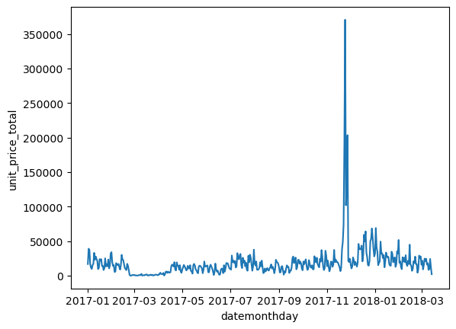
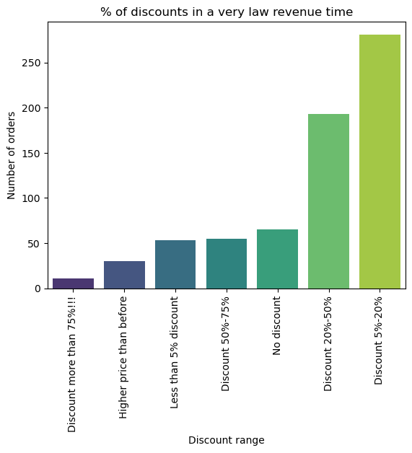
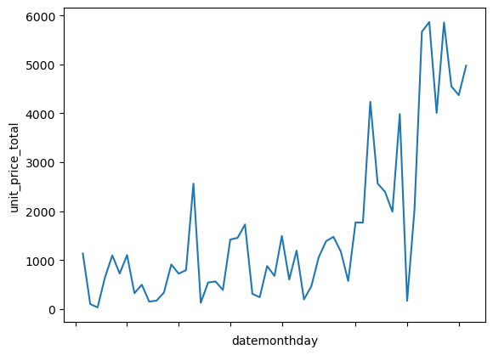
This can be removed! 23.02.2017 - 16.04.2017

Slide 20
Key Findings
Discounts are brand dependant.
When to apply discounts? seasonal discounts are preferred? such as Black Fri, Xmas, Cyber Mon?
The majority of Eniac's revenue comes from 5-20% discounted products.

Slide 21
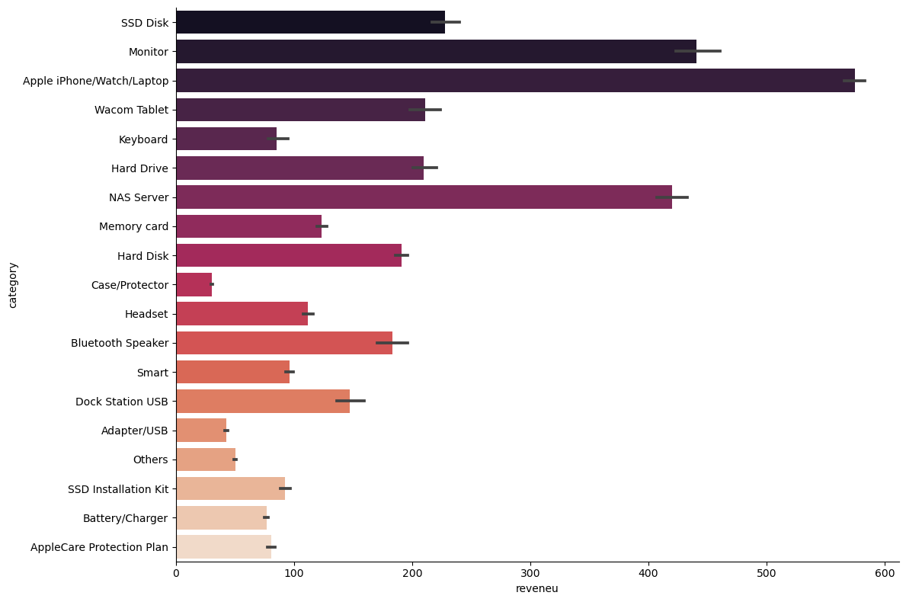
Product categories sold by revenue

Slide 22
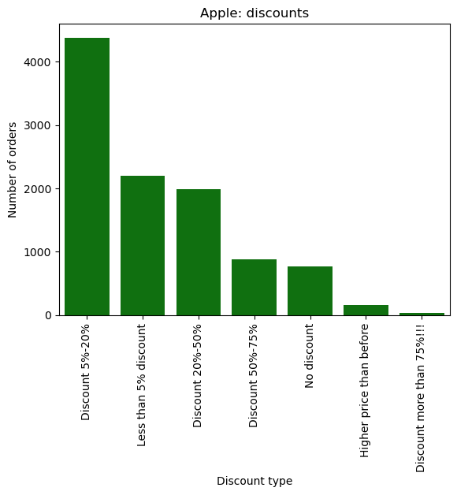
Apple discounts are small
only Apple products, didin’t apply outliers, grouped by type of discounts
Notes:
Apple is already discounts and continues to bring in the most revenue

Slide 23
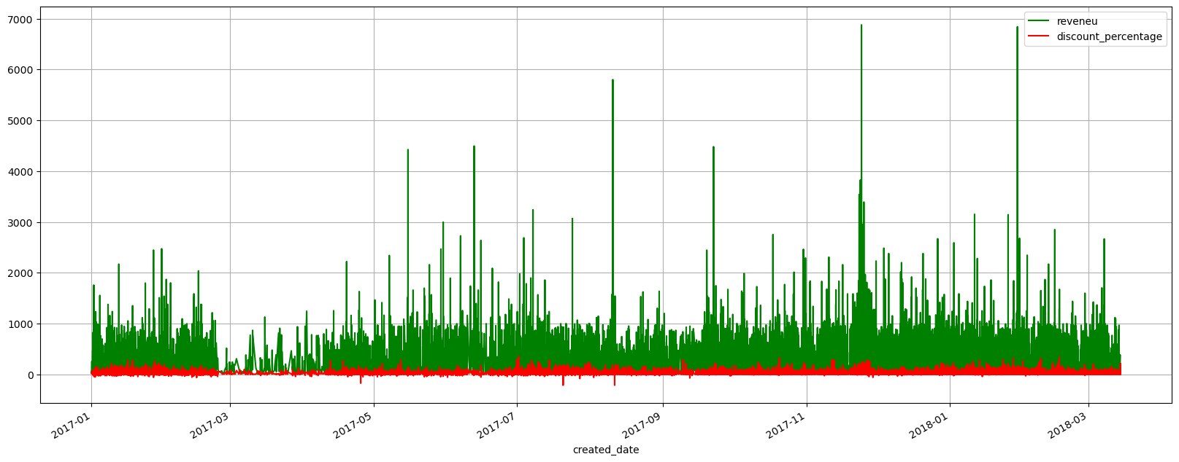
discount percentage vs revenue

Slide 24
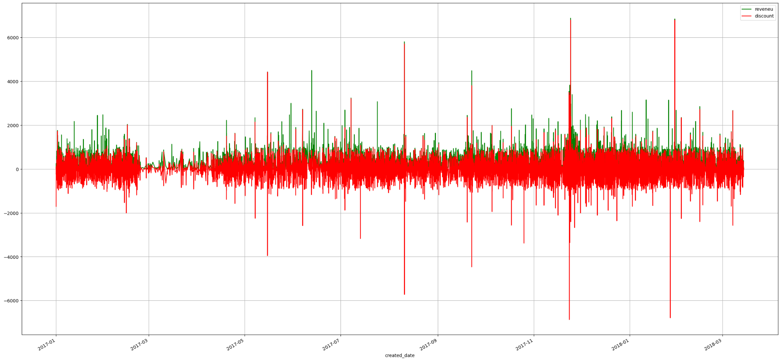
Pattern of discount and revenue contributed.

Slide 25
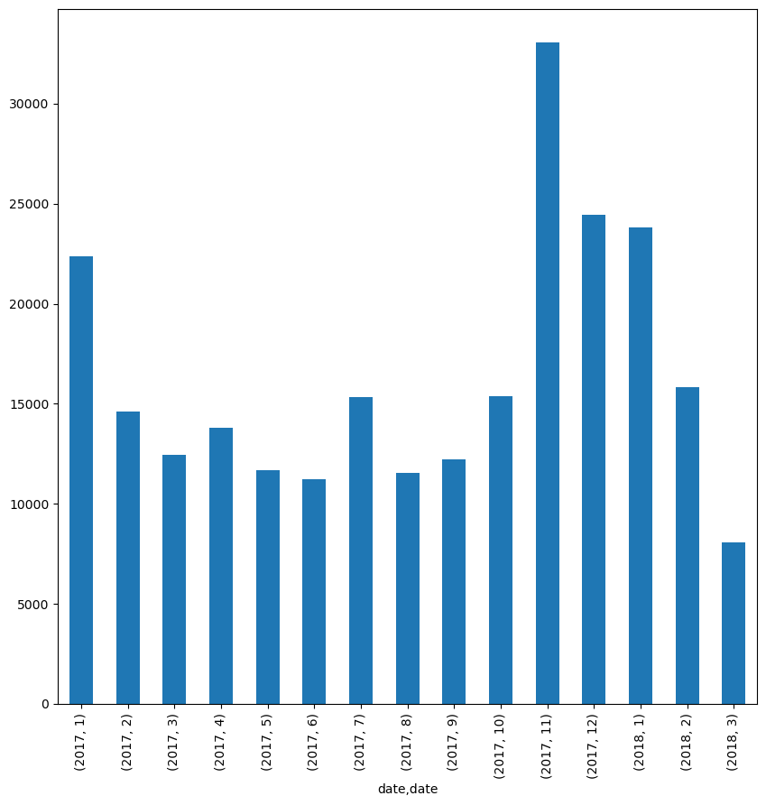
General trend of revenue for the year 2017,2018

Slide 26
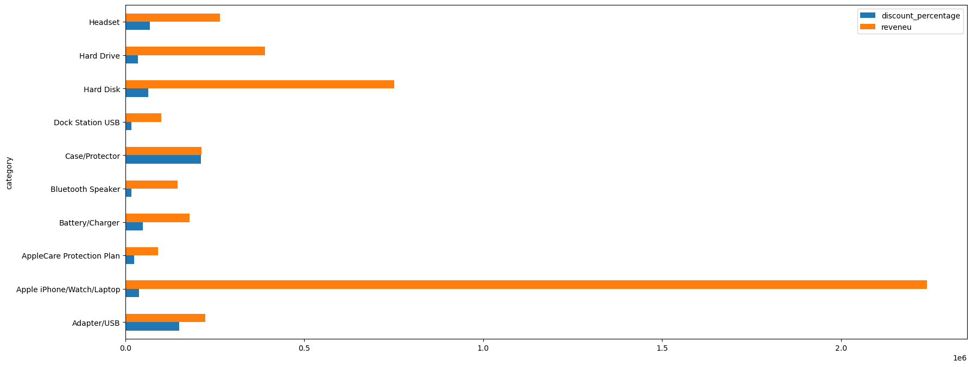
Discount percentage *mean vs Revenue *sum

Slide 27
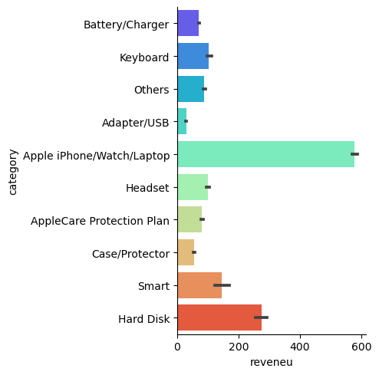
Apple’s Revenue

Slide 28
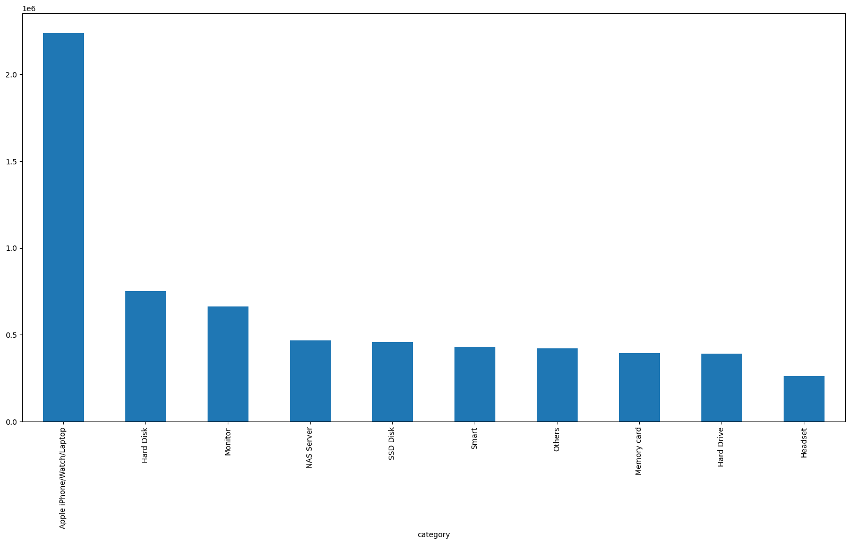
Total reveneu, 10 biggest product categories

Slide 29
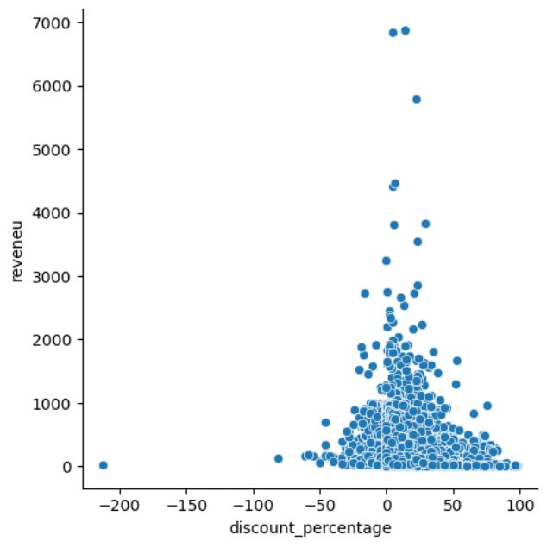
Discount vs. Revenue
no relationship
Notes:
All products

Slide 30
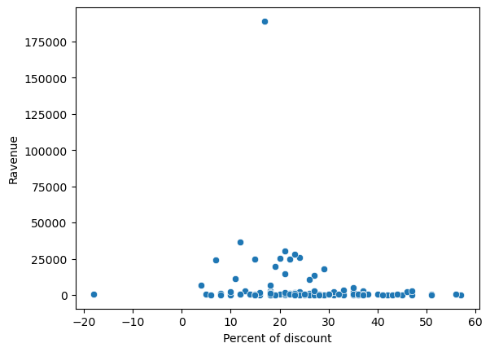
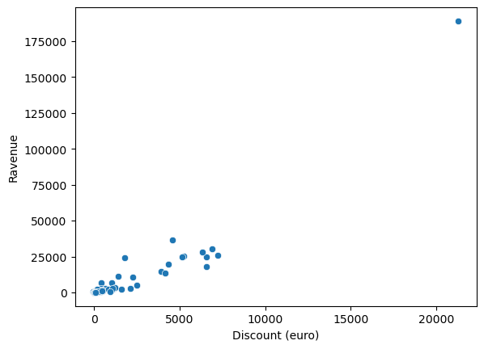
Black Friday and Cyber Monday
% of discount LESS important than amount of saved money
Apple
Apple

Slide 31
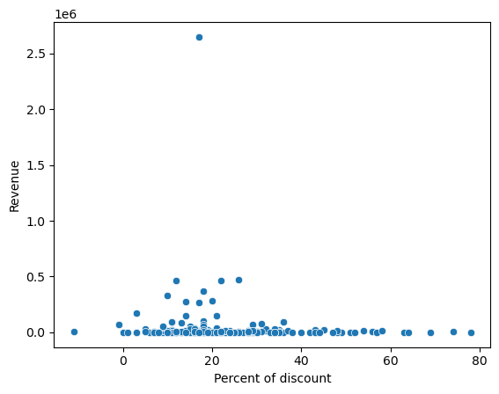
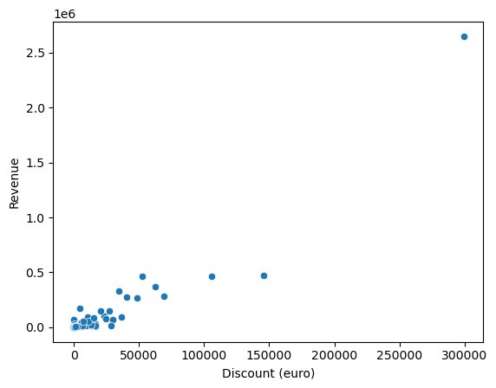
General trend:
Apple
Apple

Slide 32
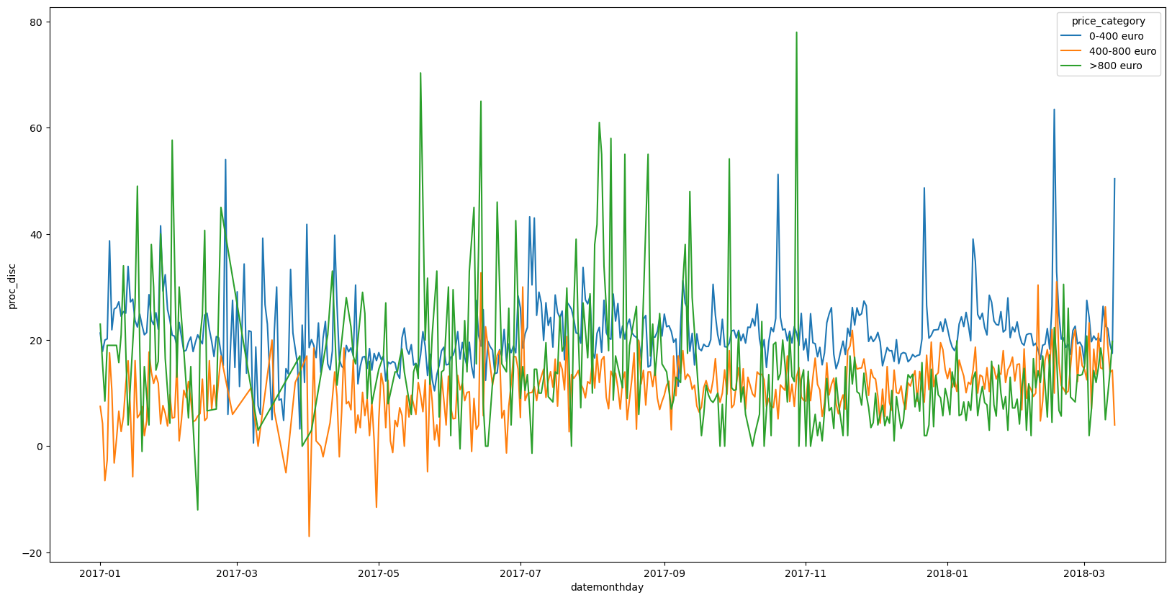
All the products: % discount

Slide 33
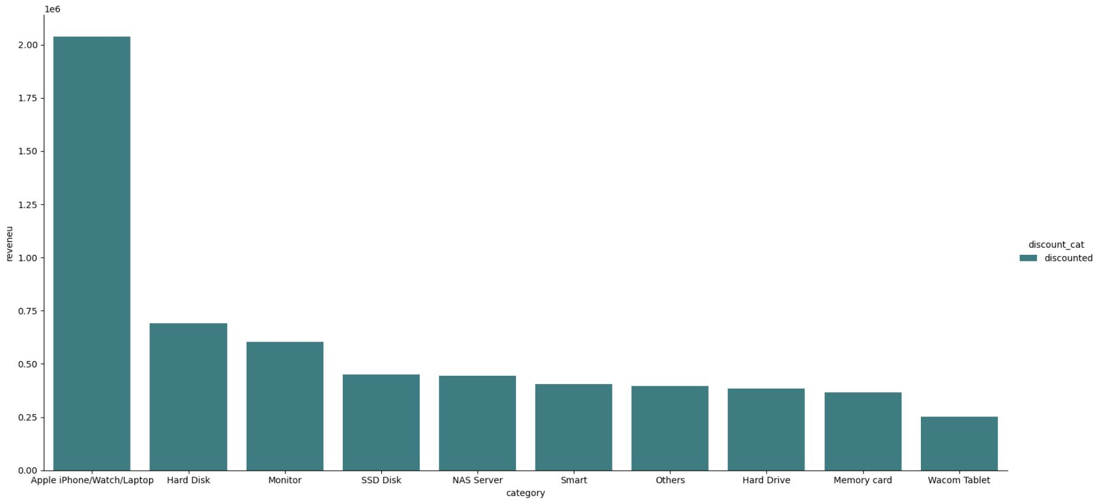
The most revenues are by discounted products.

Slide 34
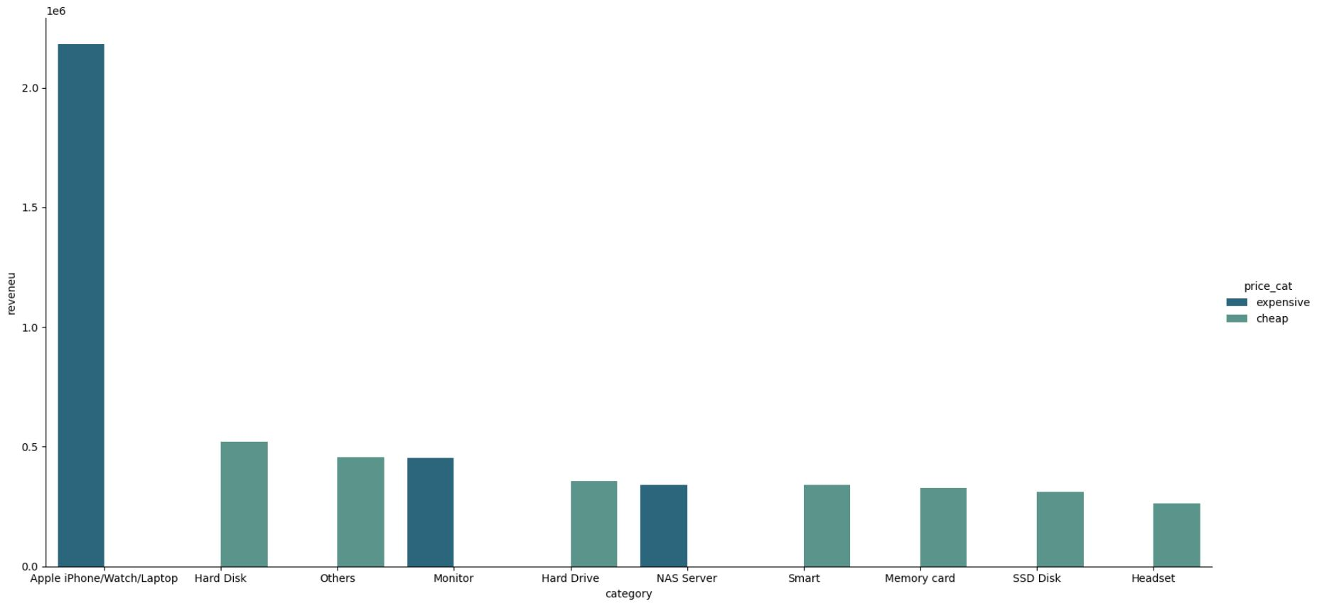
Cheap products has relevant revenue

Slide 35
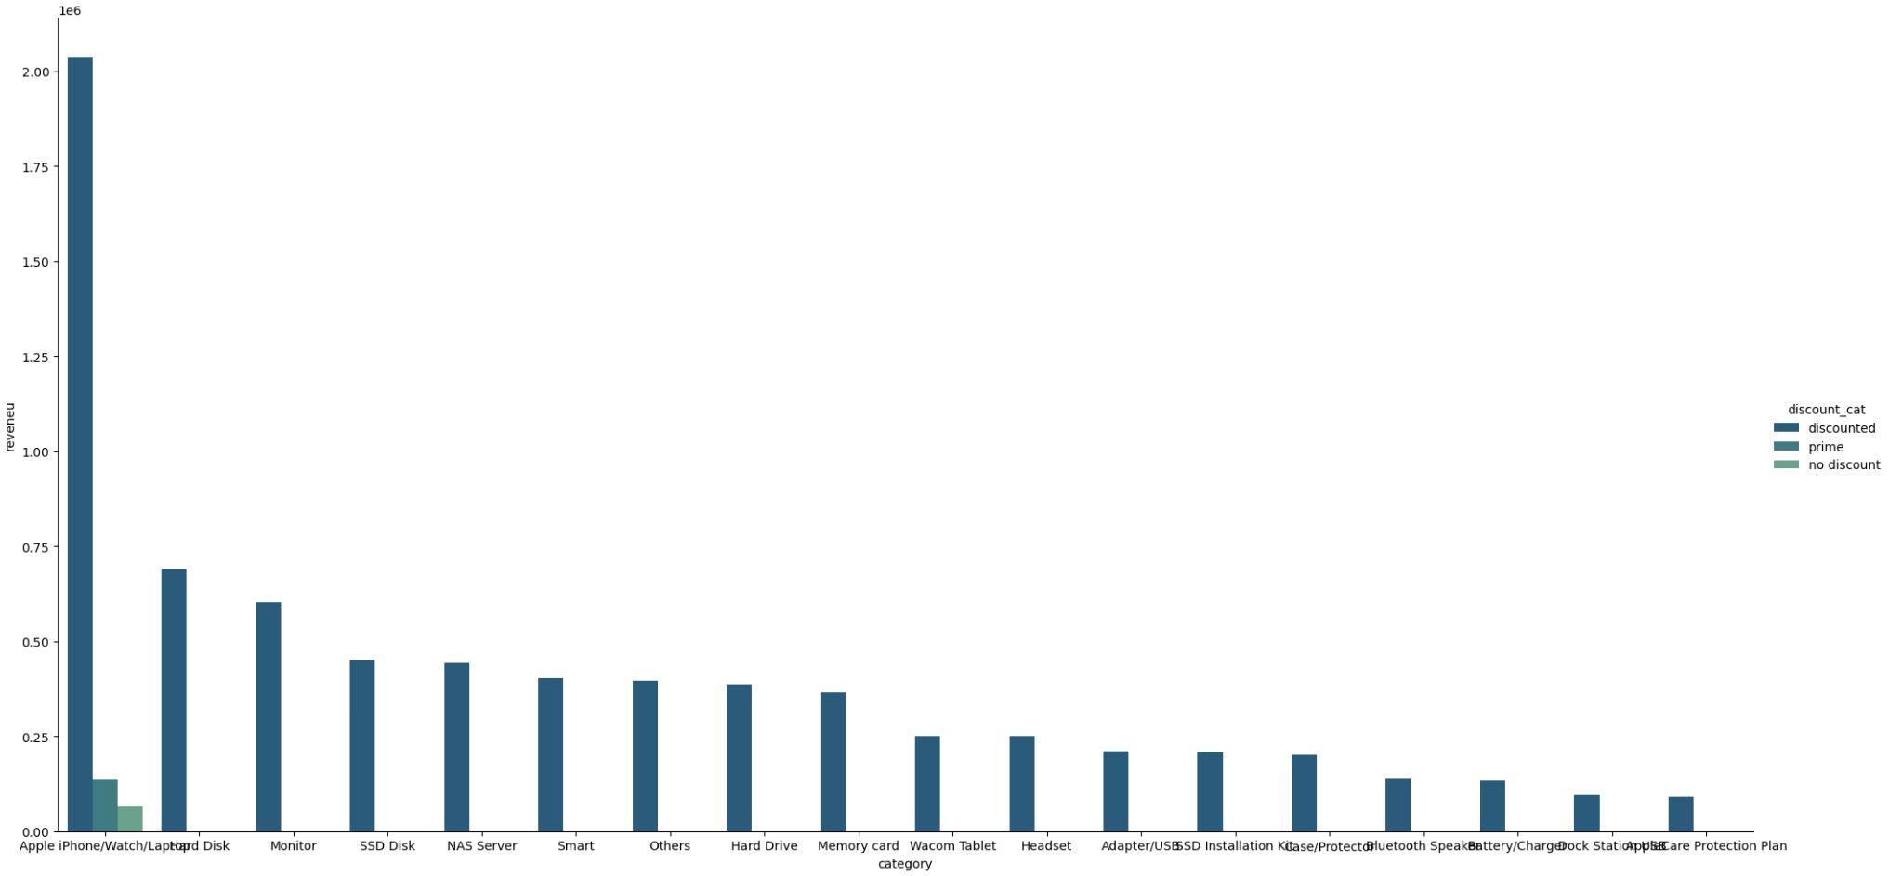
Apple high products always has the most revenue,
discounts are the big part of it

Slide 36
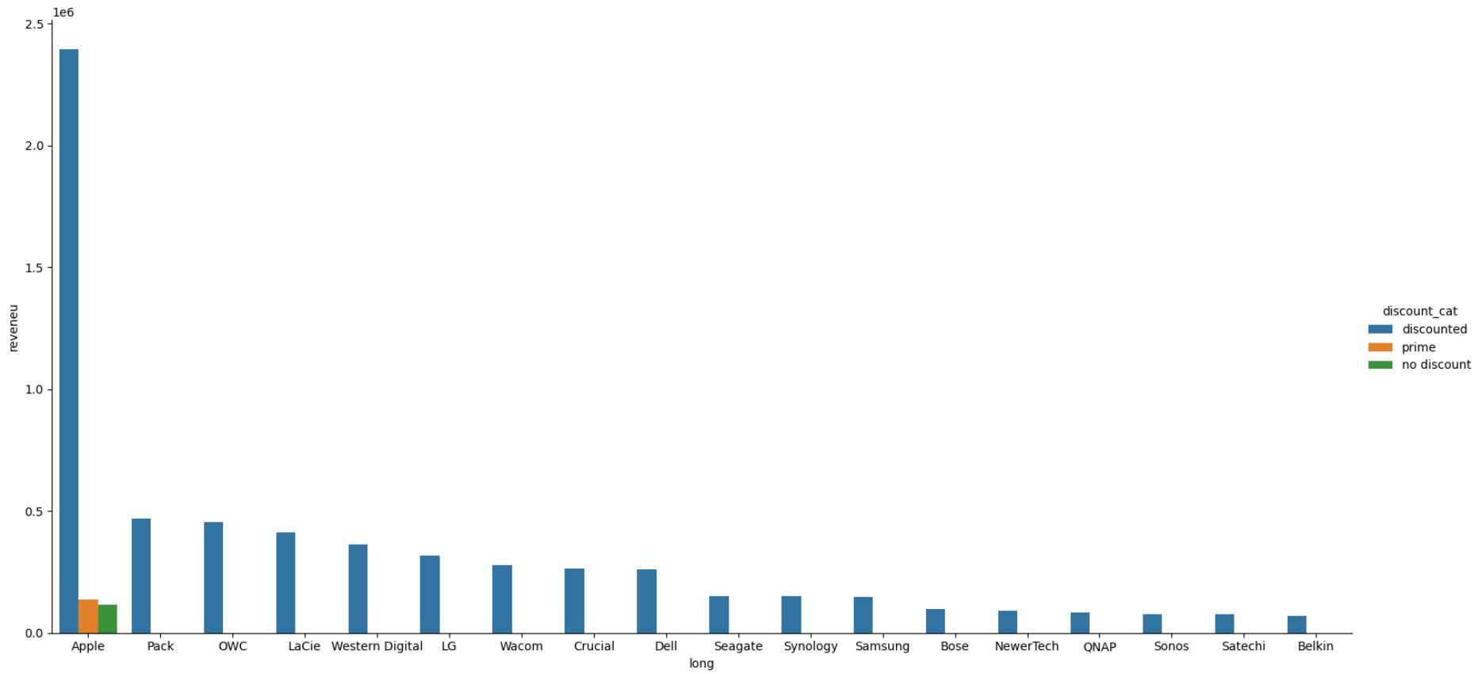
Apple has the biggest revenue, mostly discounted

Slide 37
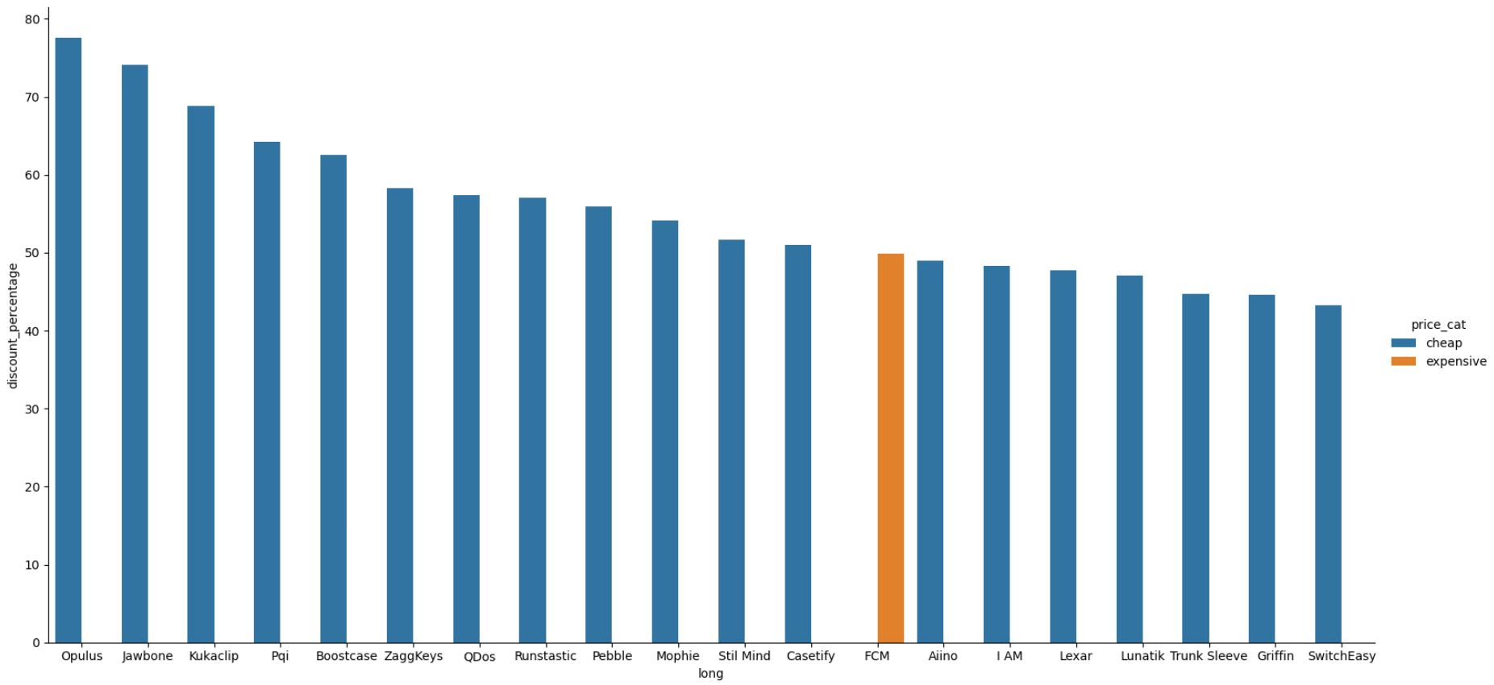
20 biggest discounts are by cheap products.

Slide 38
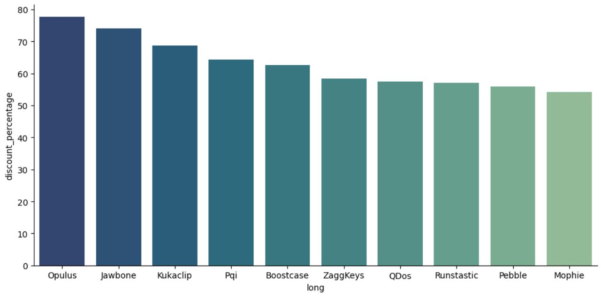
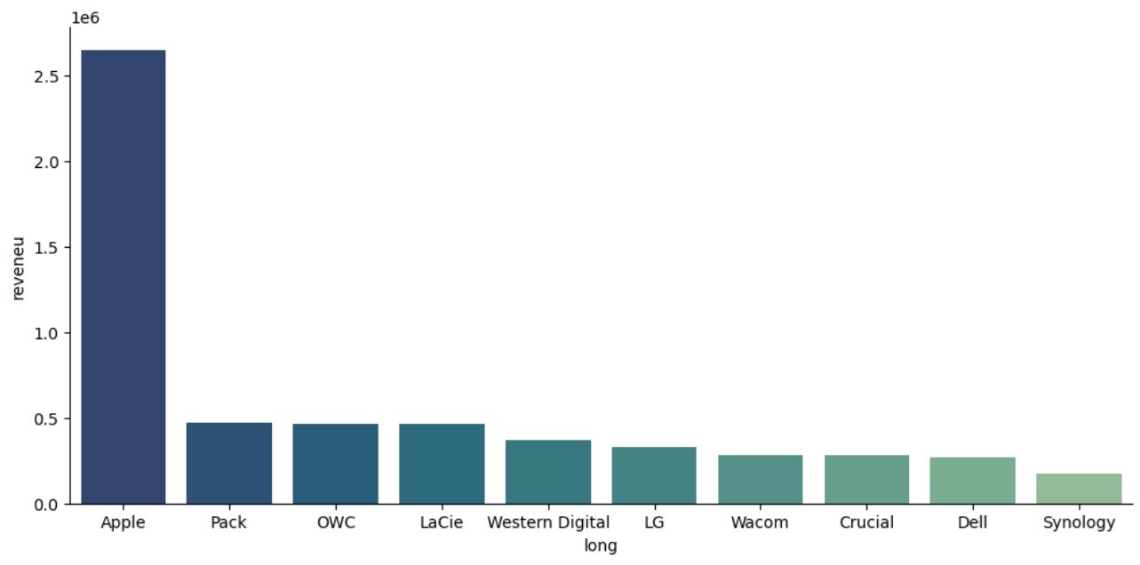
Apple has most revenue but not biggest discounts
most 10 biggest discounts
most 10 biggest
revenue

Slide 39
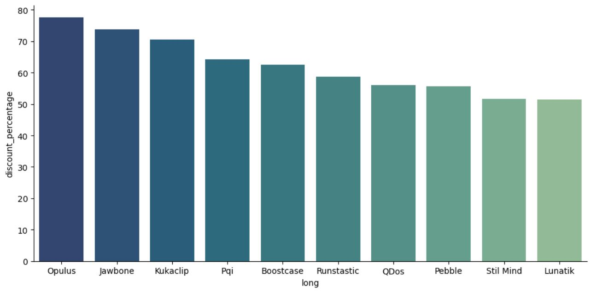
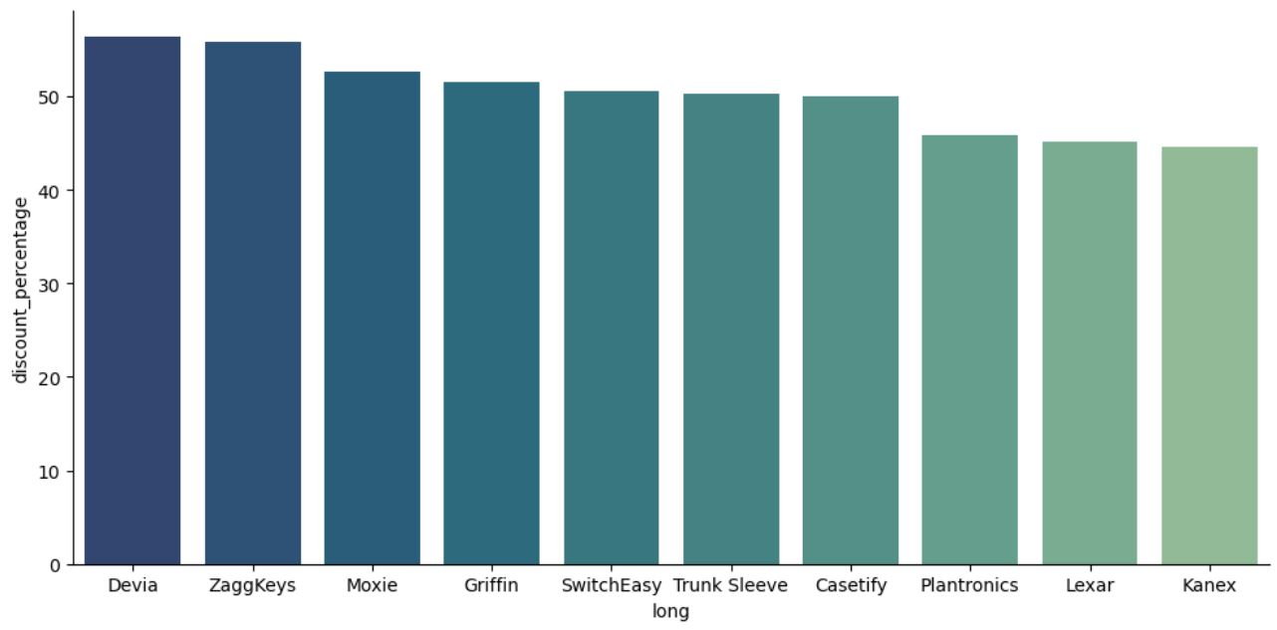
From January to November -
Apple still don’t have biggest discounts
January
November

Slide 40
33% of the revenue are coming from Apple products
most 10 biggest
revenue

Slide 41
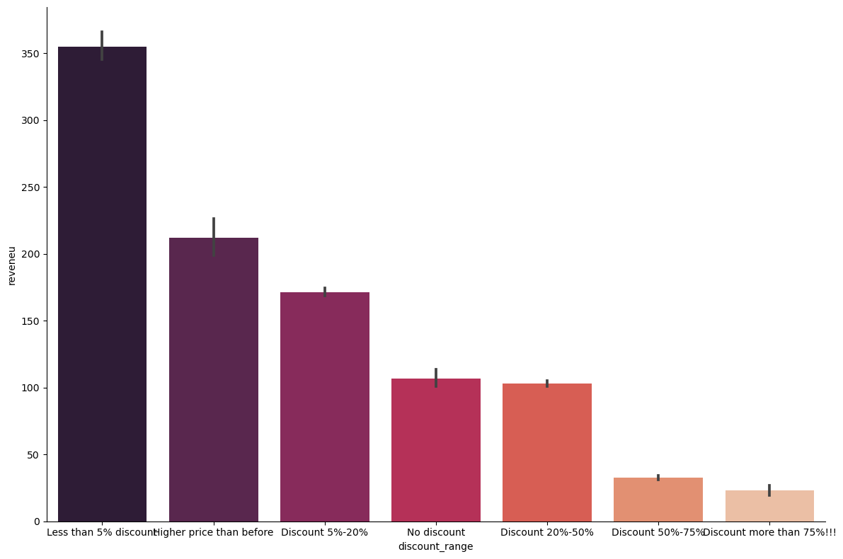
Correlation between Revenue and Discounts

Slide 42
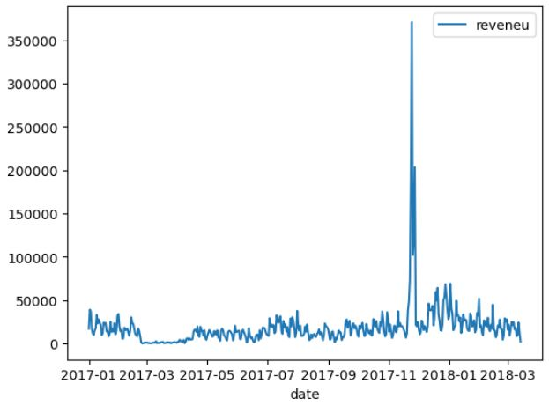
Black friday good for the revenue but
Discounts are distributing over the year
Notes:
Black Friday and Cyber Monday had an impact on the revenue

Slide 43
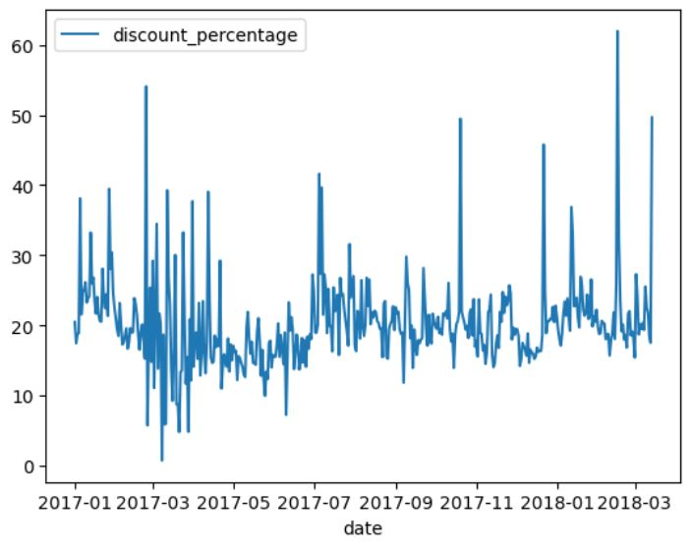
Black friday good for the revenue but
Discounts are distributing over the year

Slide 44
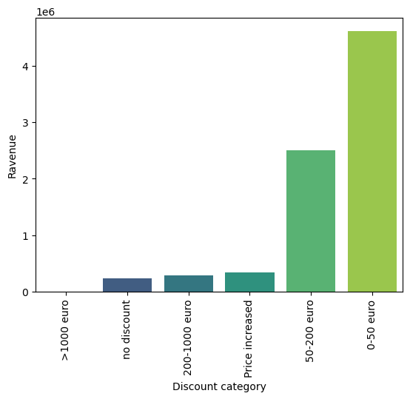
Small discounts responsible for most of the revenue.

Slide 45
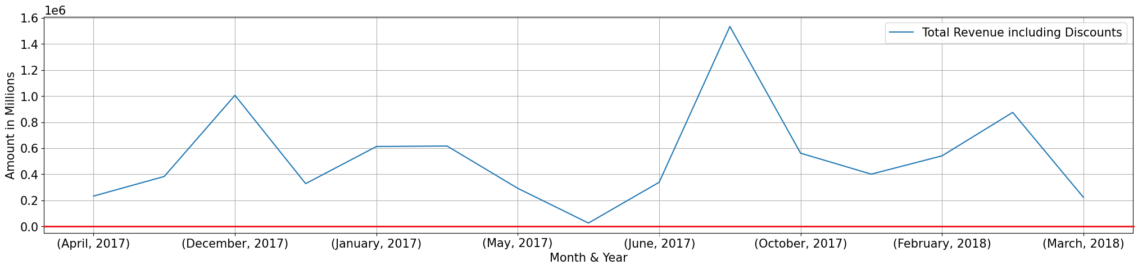
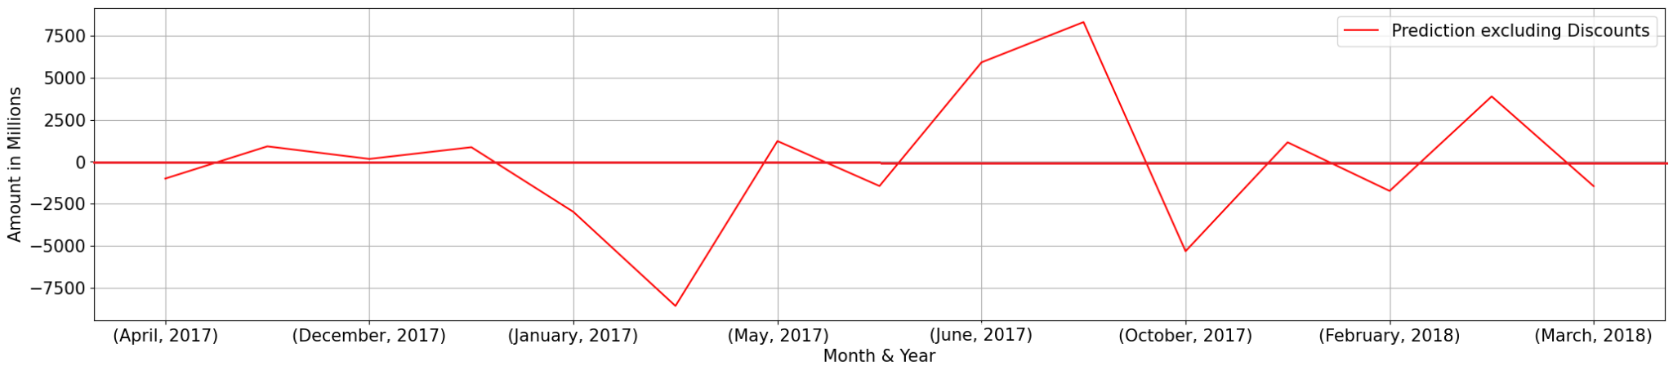
Revenue excluding Discounts
Notes:
we display these graphs to dictate how much impact a discount can have on the total revenue when taken out of the equation.

Slide 46
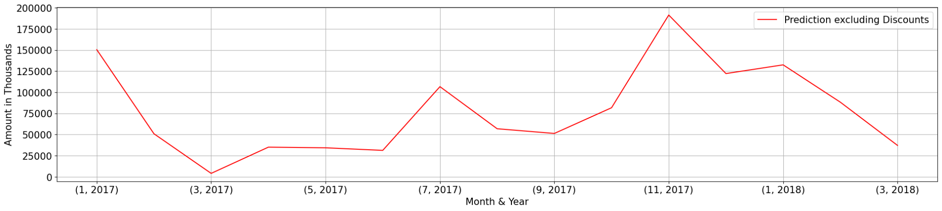
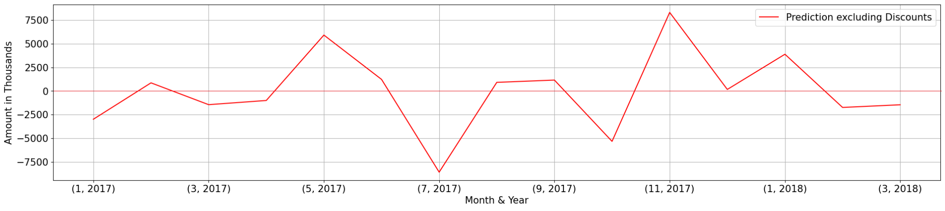

Slide 47


Slide 48

Categories made total Revenue

